Slide 1
EN-Profinet CtrlXDrive
(TIA FB´s) Quickstart
Date: 09.05.2022
Place: Lohr am Main
Author: A.Neuber
Version: V1.1

Slide 2
EN-S7Profinet CtrlXDrive
General important hint for Profinet with CtrlXDrive firmware AXS03V08-NN.00:
→ Actual max. 9 parameters works as process data, not more!!

Slide 3
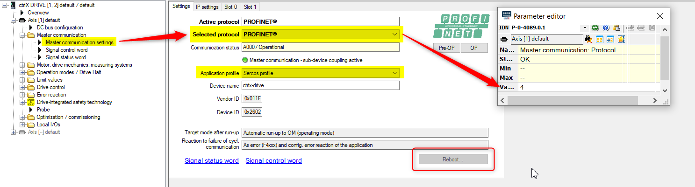
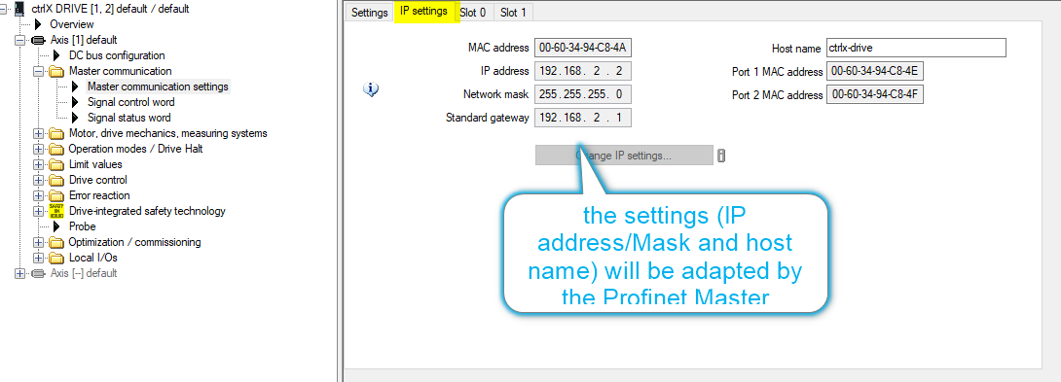
Communication parameterization ctrlx Drive
EN-S7Profinet CtrlXDrive

Slide 4
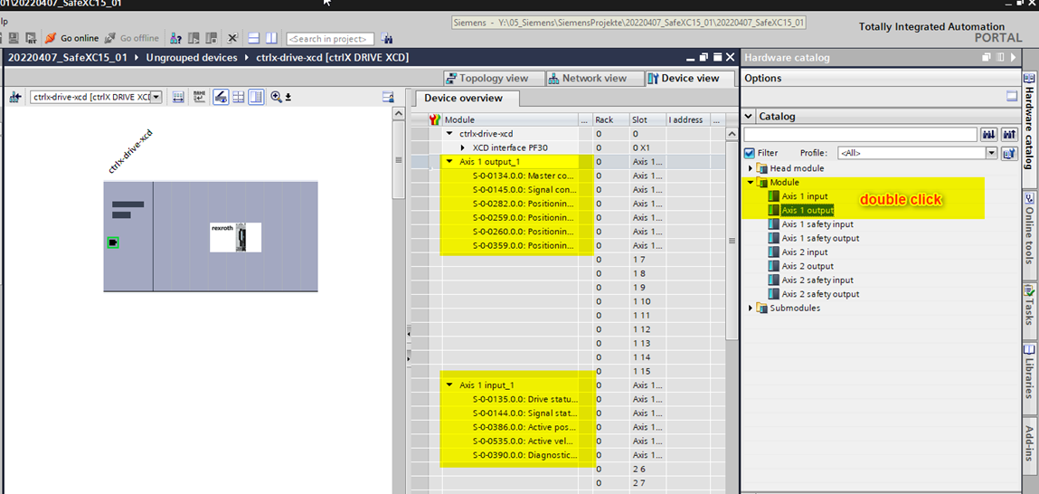
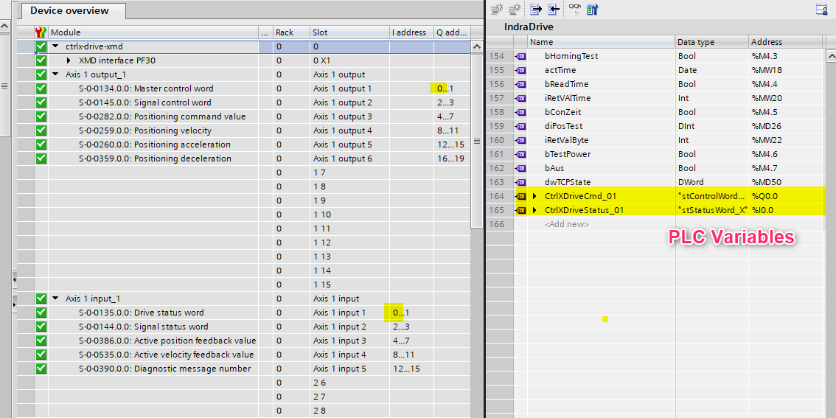
Example with SIEMENS Profinet Master
EN-S7Profinet CtrlXDrive
Douple click to start with defaulf confiugration.
Use the submodules for flexible configuration.
Use PLC Variables with datatypes to connect the process data to the functionbloc. (part of the example)

Slide 5
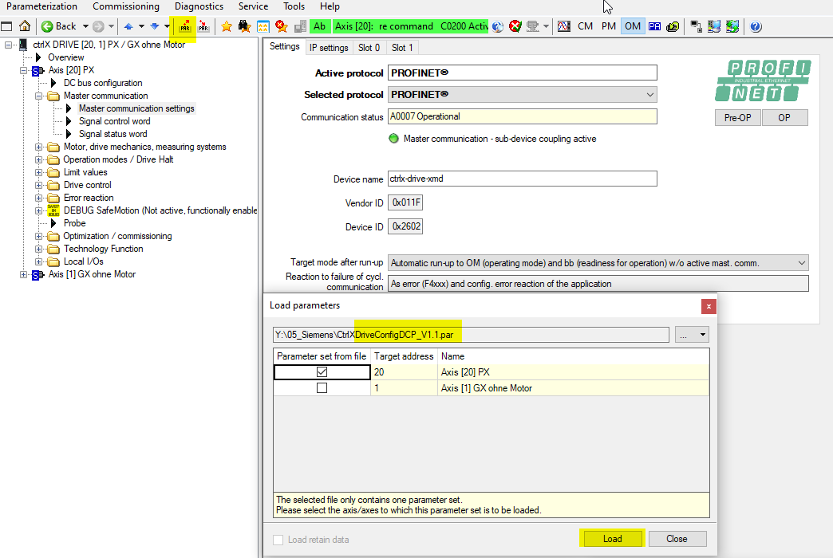
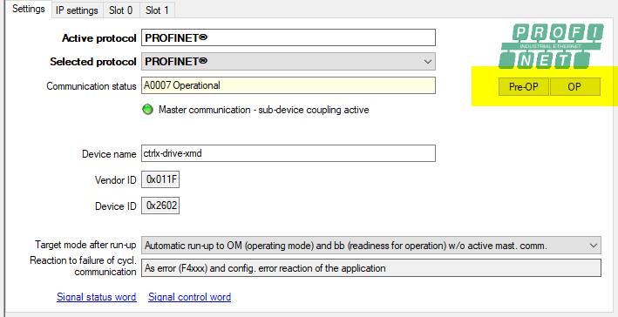
Load (small) parameter file to configure the CtrlXDrive Interface!
EN-S7Profinet IndraDrive
Loading this parameter file “CtrlXDrive..”
Connect S7 CPU with the drive
Retrieve the example project (see next side)
Open the project
Assign device name (see next side)
Start the example ( Profinet communication should be run), switch from PreOP to OP.
Activate the program example (see next side)

Slide 6
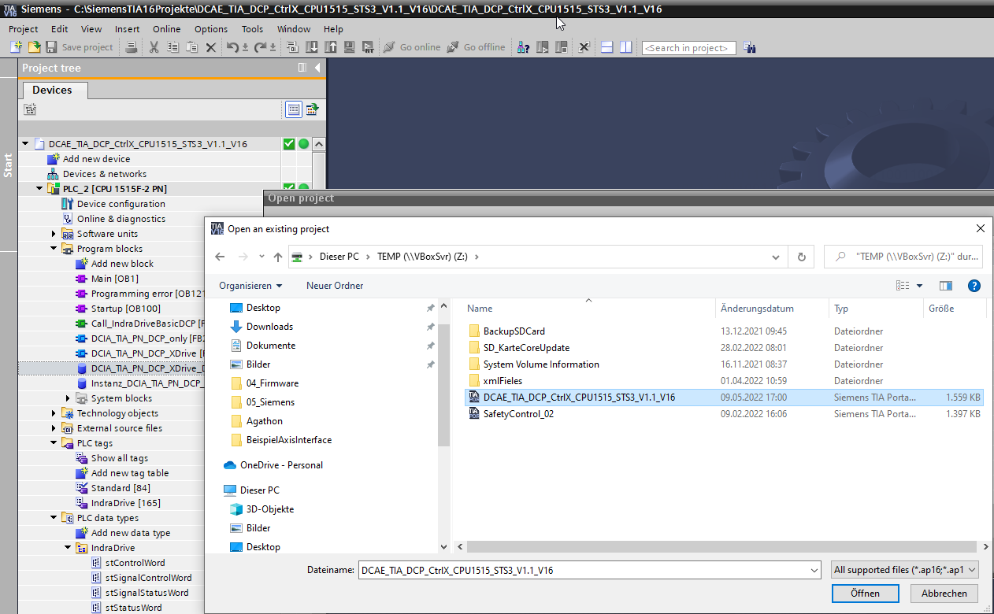
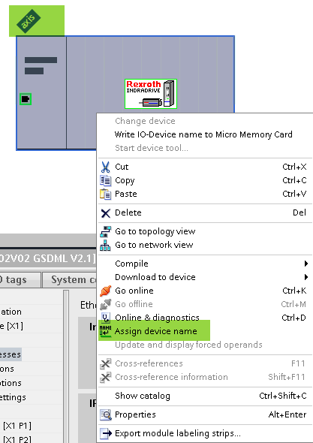
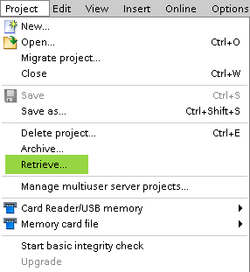
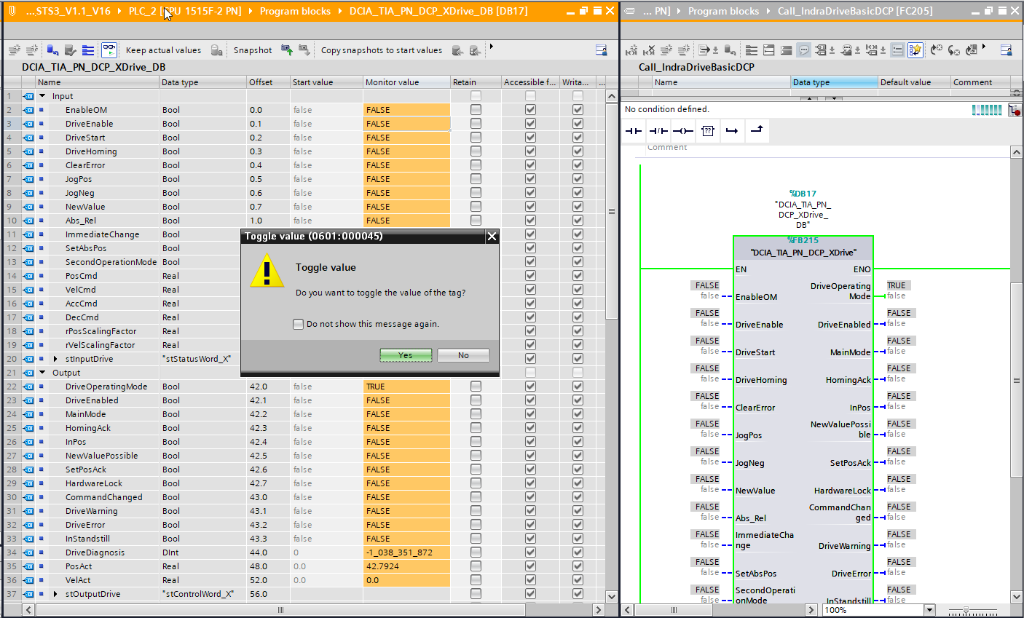
Open TIA example project
EN-S7Profinet IndraDrive
1
2
3
4

Slide 7
Open TIA example project
EN-S7Profinet IndraDrive
4
Test the function bloc directly with the instanz db.

