Slide 1
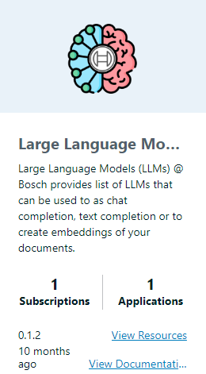

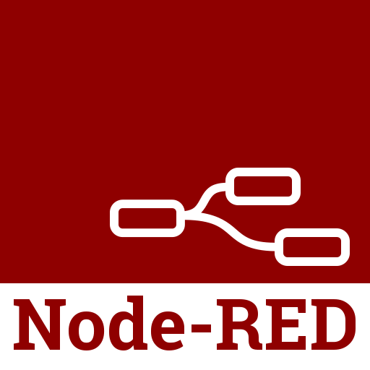
CoreVA
AI assisted coding for NodeRed on CtrlX Core (Virtual), powered by Bosch Digital open source LLMs

Slide 2
Features

Slide 3
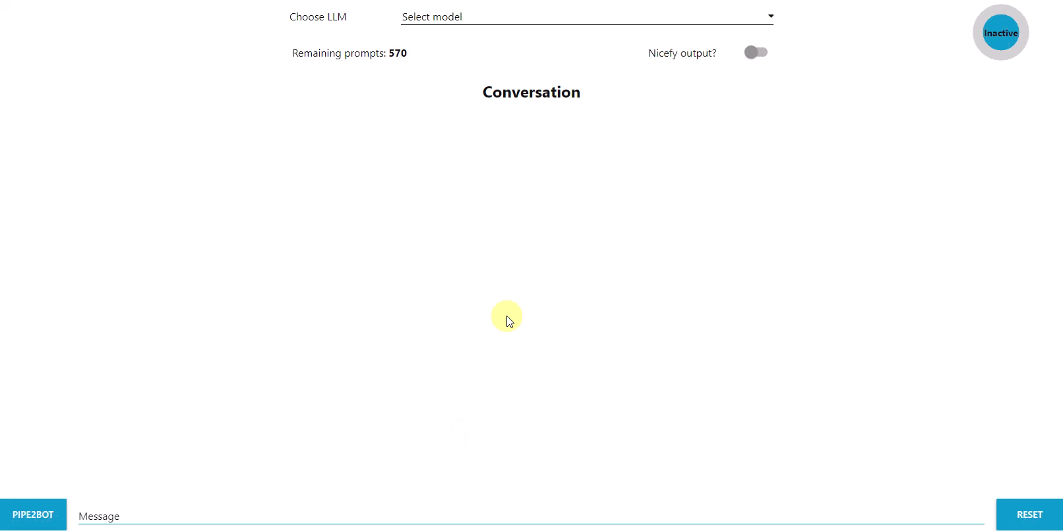
UI NodeRED dashboard
Coreva – AI assisted coding in NodeRed
Powered by open source LLMs from API marketplace https://marketplace.api.bosch.com/
Allows to change LLM in running conversation, while context remains
Customizable system prompt
Enables piping the output msg of any NodeRed flow‘s node of interest directly to the LLM prompt

Slide 4
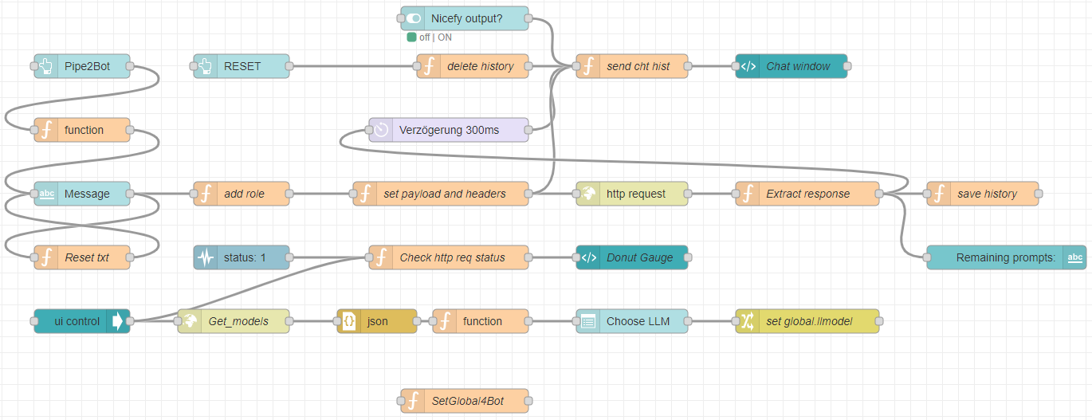
Flow
Coreva – AI assisted coding in NodeRed
Define system prompt
Set API key here
Connect this node to any output in order to pipe msg object to chat prompt

Slide 5
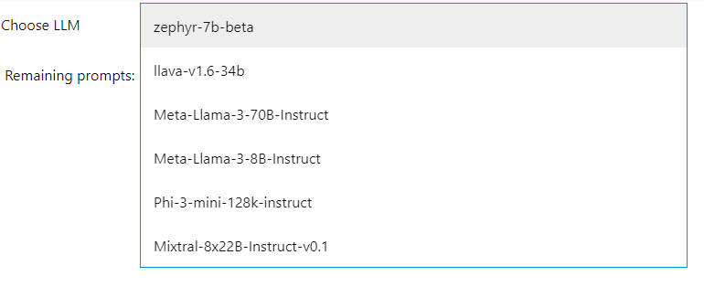
Switching large language models
Coreva – AI assisted coding in NodeRed
Upon loading the dashboard in the browser, available models are dynamically inquiried from server (Link)
The UI pull down menu is populated on the fly with all available models
User can choose model for running inference with a click
Model can be changed in running conversation, context remains

Slide 6

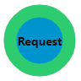



UX features
Coreva – AI assisted coding in NodeRed
Animated indicator showing ongoing http request/chat bot answer generation
Indicator showing remaining number of prompts
  Specific to subscription model based on API marketplace (Link), extracted via JSON.parse(msg.headers['x-rate-limit']);
Pipe2Bot
  Connect the SetGlobal4Bot–node to the output of a node of interest
  Run the flow, output is saved to a global variable
  Push the PIPE2BOT button on the UI, the msg object is JSON stringified and written directly into the chat prompt
  User inquiry can be added before/after/in between chat prompt before sending

Slide 7

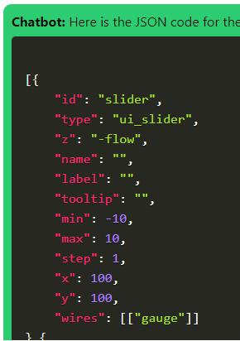
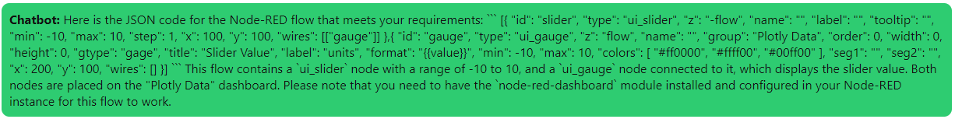
Output formatting
Coreva – AI assisted coding in NodeRed
Allows user to switch between plain text (bottom) and formatted (right) output of the conversation
Utilizing Prism.highlightAll() from https://cdnjs.cloudflare.com/ajax/libs/prism/1.25.0/prism.min.js

Slide 8
Use cases

Slide 9
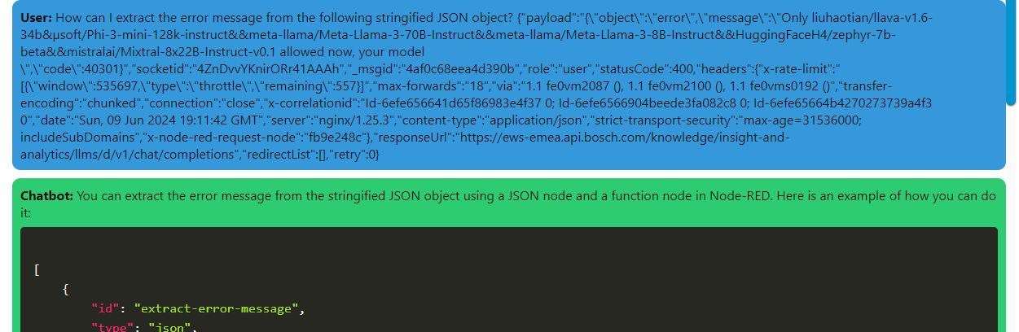
Decipher output signals from nodes
Coreva – AI assisted coding in NodeRed
Connected SetGlobal4Bot node to output of errorneous http request, inquired chatbot how to extract error message
Answer correctly given, embedded in function node:
msg.payload = JSON.parse(msg.payload).message;

Slide 10
Decipher output signals from nodes – DEMO 1/2
Coreva – AI assisted coding in NodeRed
In the following screencast, it is demonstrated how the output of a http request to google.de can be processed via CoreVA to yield a function node that filters some desired information
For this, the SetGlobal4Bot node is connected to the respective output and the response then inserted into the LLM prompt
The following request is pasted into the prompt before the msg object: “Please give me a node red function node that extracts the status code from the object I provide, and returns it as payload of an otherwise empty message. You need to store the status code into a temporary variable first, end then initialize the msg object to empty it. Here comes the object from a debug node: “
You can also see the “Nicefy” feature in action

Slide 11
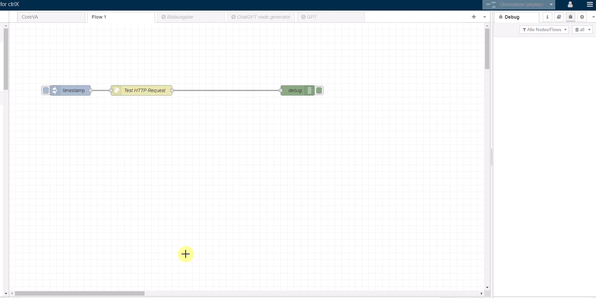
Decipher output signals from nodes – DEMO 2/2
Coreva – AI assisted coding in NodeRed

Slide 12
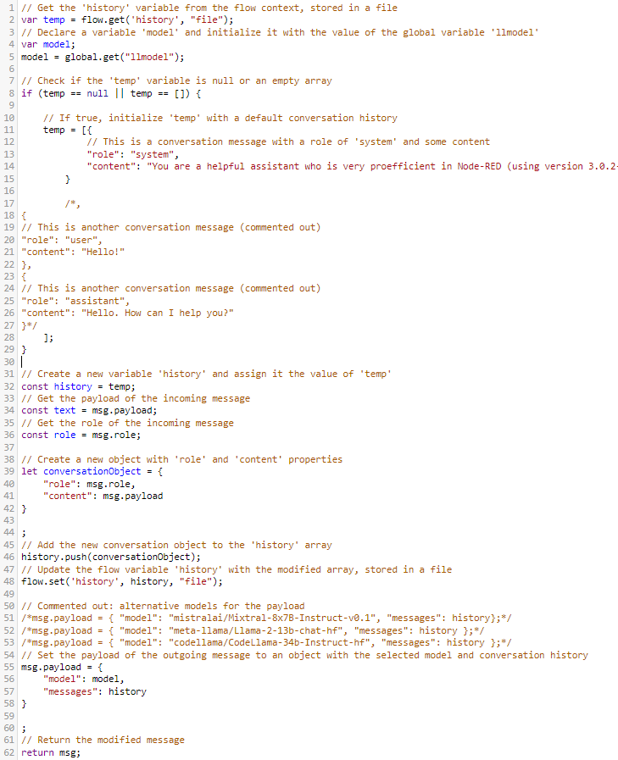
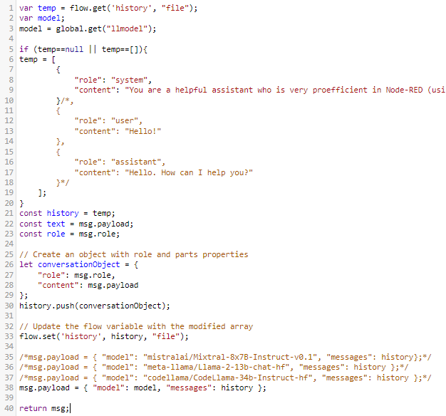
Documenting/explaining code
Coreva – AI assisted coding in NodeRed
Please comment the following code line by line, so that a beginner can understand what it is doing:
This code appears to be managing a conversation history and selecting a language model for a chatbot or AI assistant. It stores the conversation history in a flow variable and updates it with each new message. The selected model is then used to generate a response to the user.

Slide 13
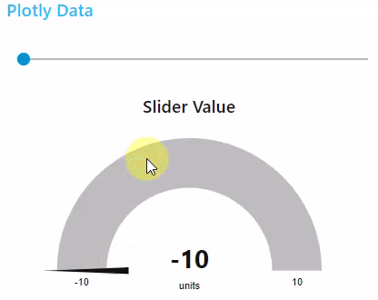
Low coding with LLM
[{
"id": "slider",
"type": "ui_slider",
"z": "-flow",
"name": "",
"label": "",
"tooltip": "",
"min": -10,
"max": 10,
"step": 1,
"x": 100,
"y": 100,
"wires": [["gauge"]]
},{
"id": "gauge",
"type": "ui_gauge",
"z": "flow",
"name": "",
"group": "Plotly Data",
"order": 0,
"width": 0,
"height": 0,
"gtype": "gage",
"title": "Slider Value",
"label": "units",
"format": "{{value}}",
"min": -10,
"max": 10,
"colors": [
"#ff0000",
"#ffff00",
"#00ff00"
],
"seg1": "",
"seg2": "",
"x": 200,
"y": 100,
"wires": []
}]
Coreva – AI assisted coding in NodeRed
User: Please send me the json code for a nodered flow that contains a slider, value range from -10 to 10, and a gauge connectetd to it displaying the slider values. All should appear on the "Plotly Data" dashboard.
Chatbot: Here is the JSON code for the Node-RED flow that meets your requirements: Code see right This flow contains a `ui_slider` node with a range of -10 to 10, and a `ui_gauge` node connected to it, which displays the slider value. Both nodes are placed on the "Plotly Data" dashboard. Please note that you need to have the `node-red-dashboard` module installed and configured in your Node-RED instance for this flow to work.
Worked via direct import into NodeRed flow →

