Slide 1
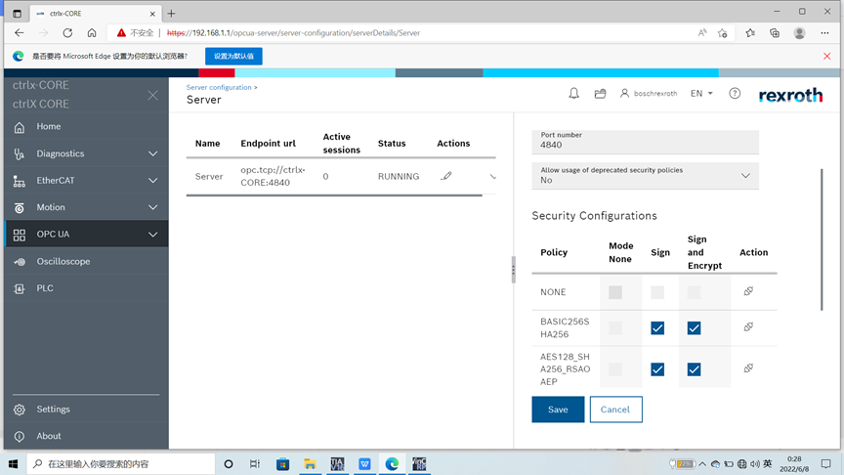
Configuration in ctrlX Core for OPC UA server

Slide 2
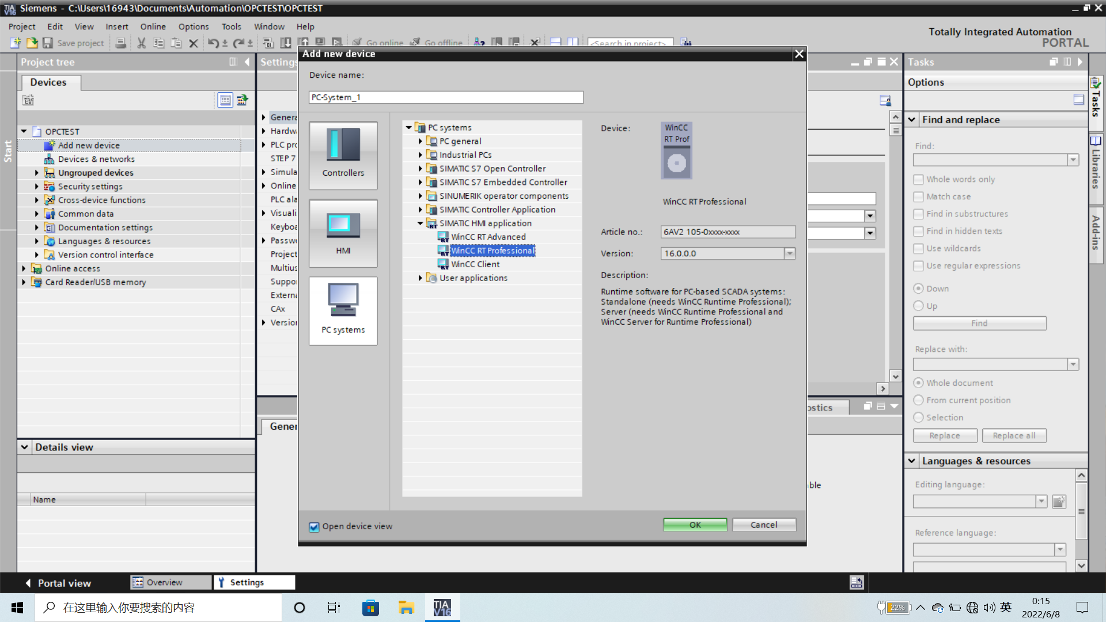
Version of WinCC RT Professional is 16.0.0

Slide 3
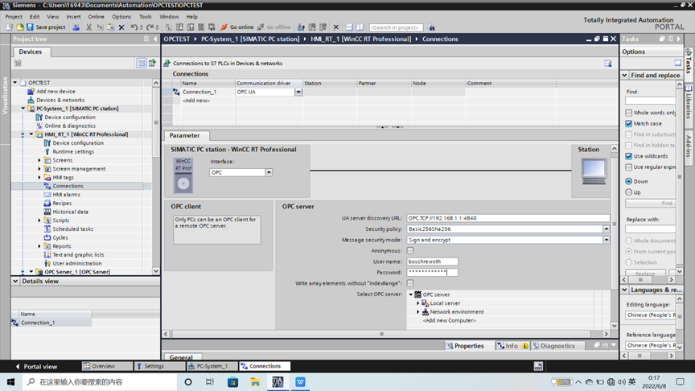
Configuration of OPC UA client in TIA Portal

Slide 4
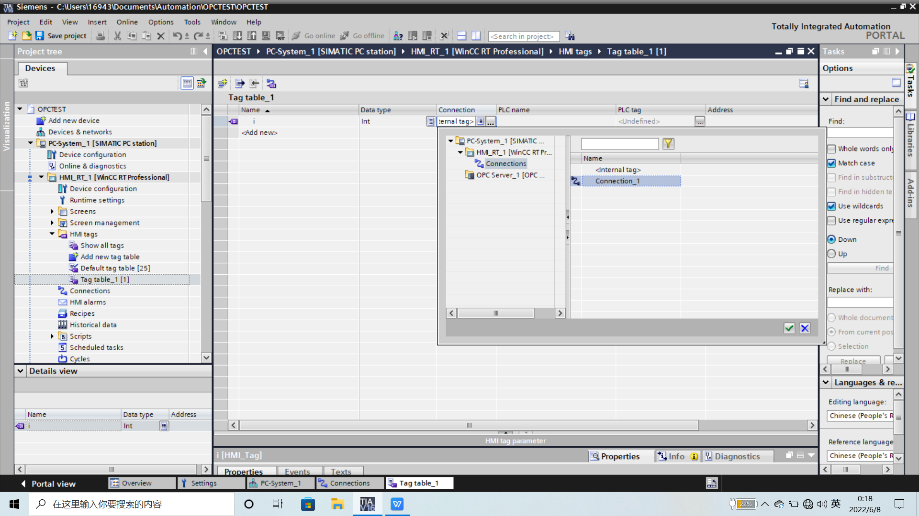
The OPC UA connection was successful

Slide 5
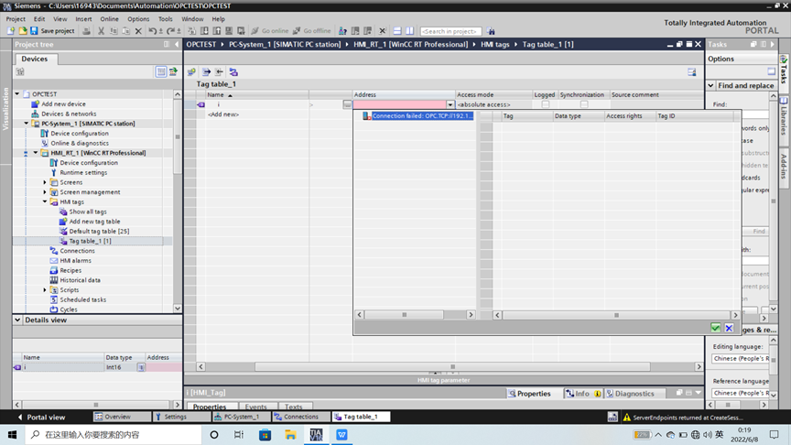
The OPC UA connection was successful

Slide 6
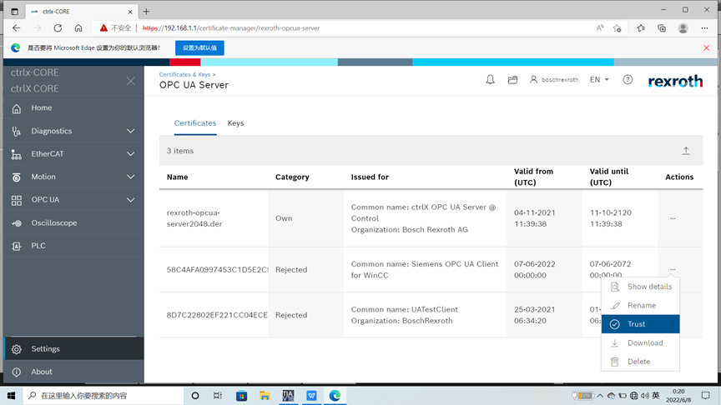
The certificate from WinCC is received by ctrlX Core and we set it to “Trust”

Slide 7
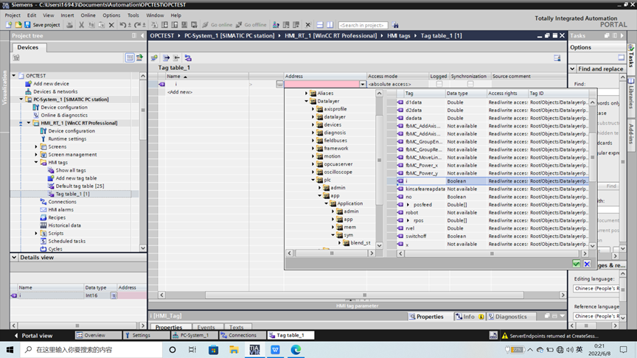
In TIA portal, we can find that the datalayer is scanned and found properly.

Slide 8
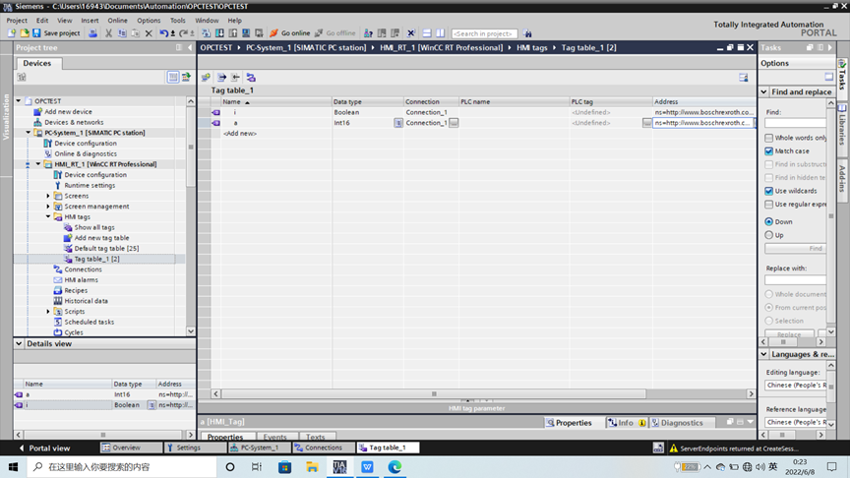
2 variables were added in WinCC in TIA portal

Slide 9
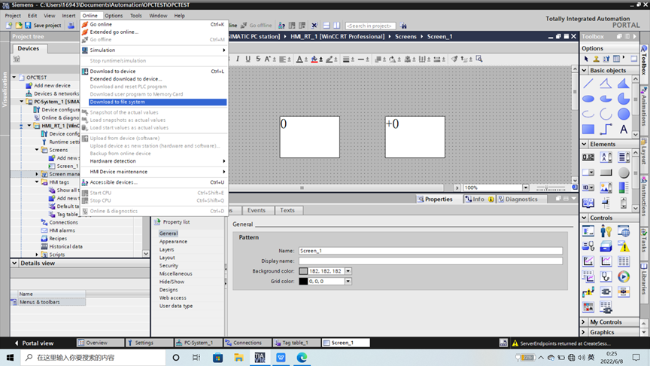
We have made a simple test with HMI and downloaded to file system

Slide 10
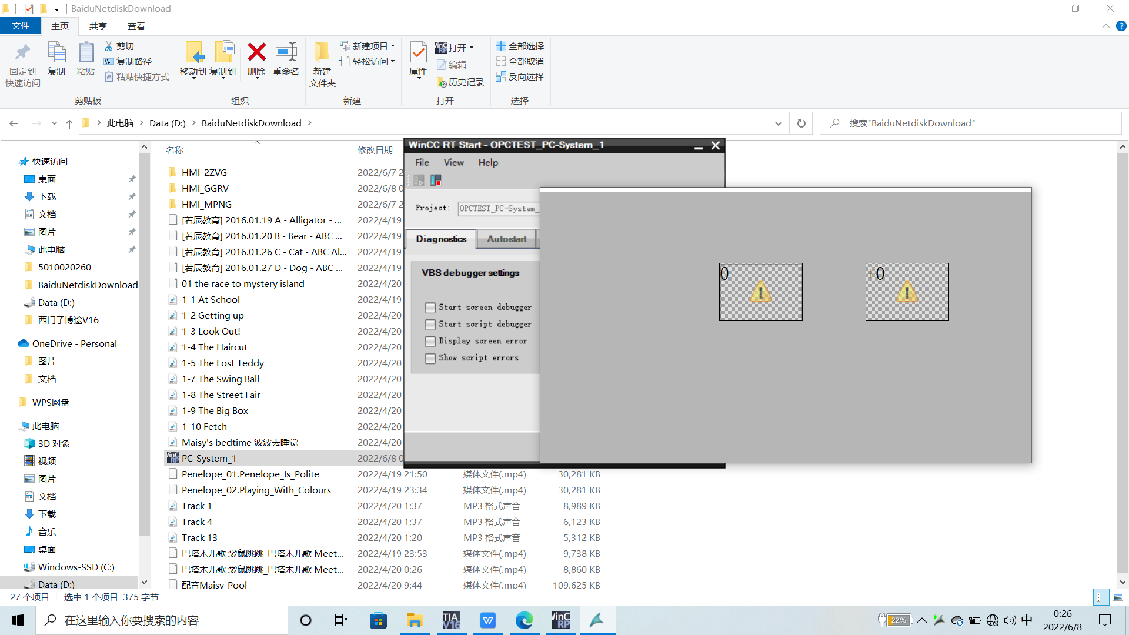
In activated HMI, the variables were not showed correctly.
The read and write for those variables was also not working.

