Slide 1
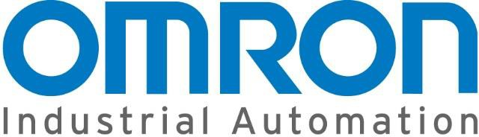
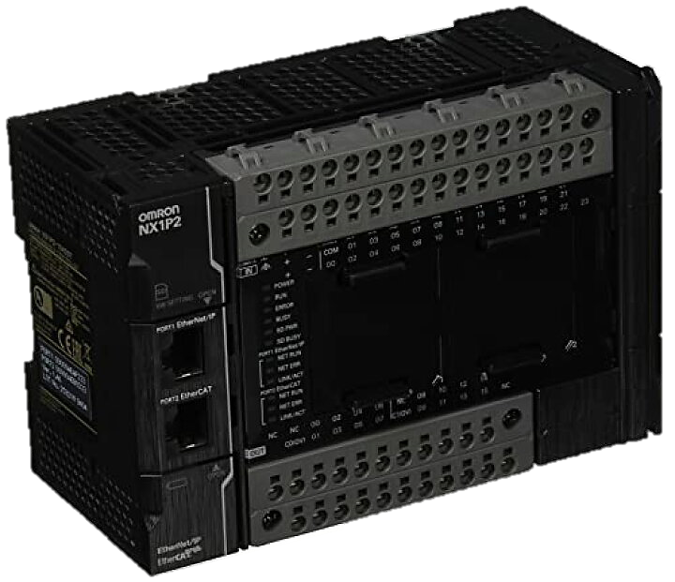
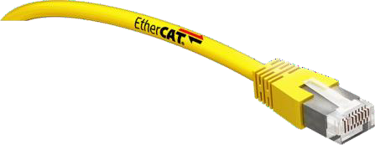
OMRON PLC with ctrlx Drive on EtherCat CoE

Slide 2
Test Bench Information
OMRON PLC with ctrlx Drive on EtherCat CoE
PLC : OMRON NX Series controller NX1P2-1040DT1 : Unit Version1.42
SYSMAC Software : V1.52.0.10
Ctrlx Drive : XMD Firmware : AXS-C-0314
Project Example :

Slide 3
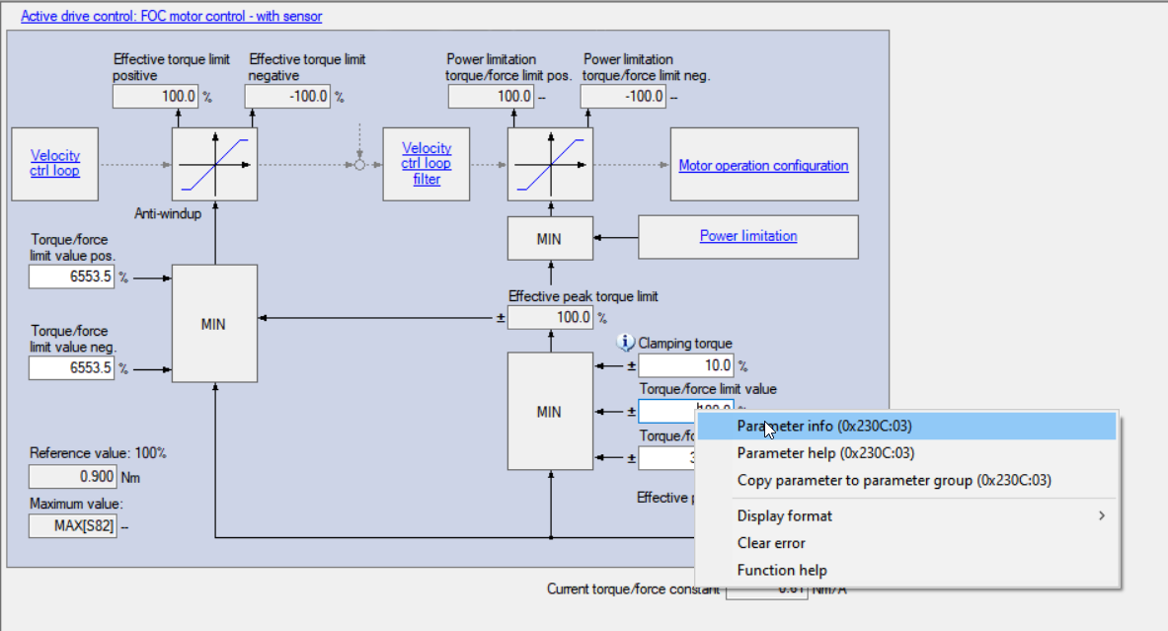
Ctrlx Drive
OMRON PLC with ctrlx Drive on EtherCat CoE
Ctrlx Drive must be configured as an EtherCat CoE Slave with CiA402 Drive Profile,
A right click on each parameter give the CAN Parameter equvalent to Sercos parameter S/P

Slide 4
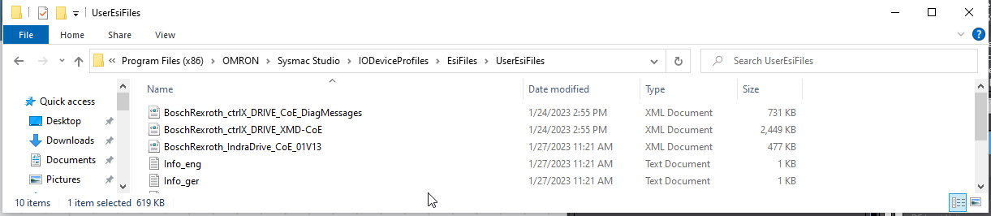
XML Files installation
OMRON PLC with ctrlx Drive on EtherCat CoE
The ESI Files of ctrlx Drive could be installed directly in :
C:\Program Files (x86)\OMRON\Sysmac Studio\IODeviceProfiles\EsiFiles\UserEsiFiles

Slide 5
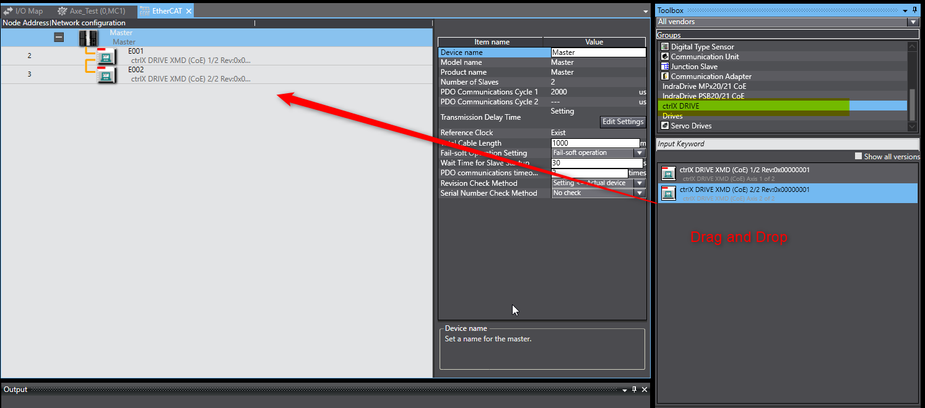
Create Project and add ctrx Drive
OMRON PLC with ctrlx Drive on EtherCat CoE

Slide 6
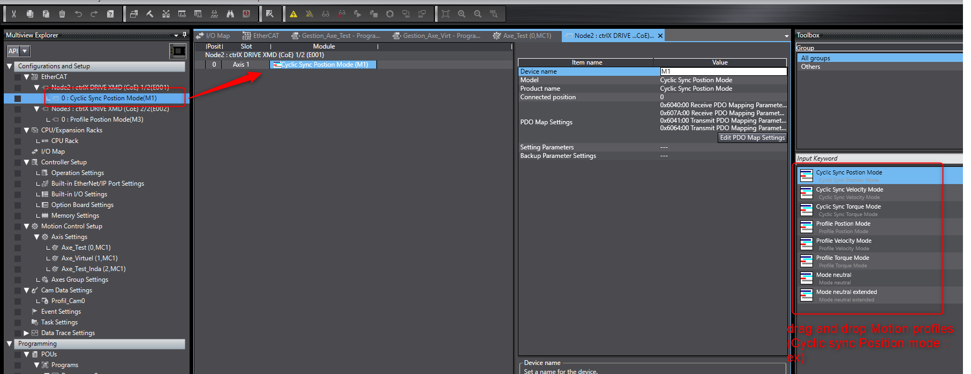
Axis Configuration – Motion Profile
OMRON PLC with ctrlx Drive on EtherCat CoE
Choose the required CiA402 Motion Profil and insert it in the module, a PDO Map table will be automatically generated

Slide 7
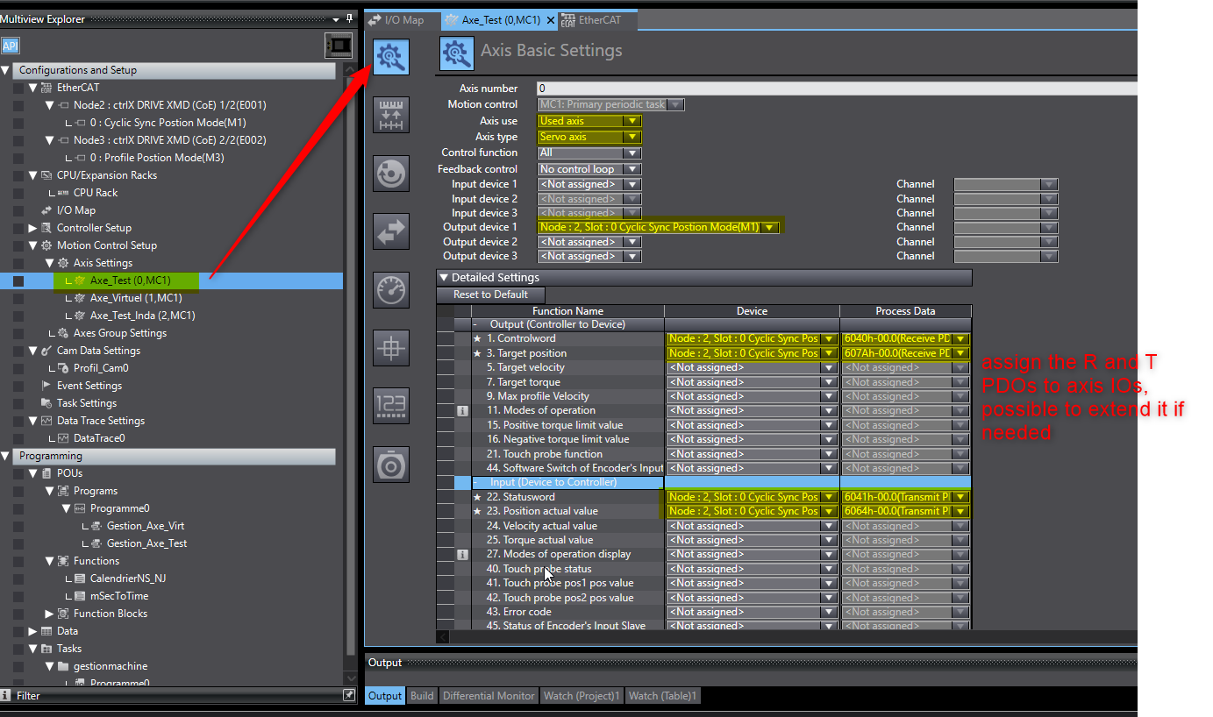
Link ctrlx Drive to a Motion Axis
OMRON PLC with ctrlx Drive on EtherCat CoE
The Drive has to be linked to a Motion Axis ans assigning the Process data to Axis IOs

Slide 8
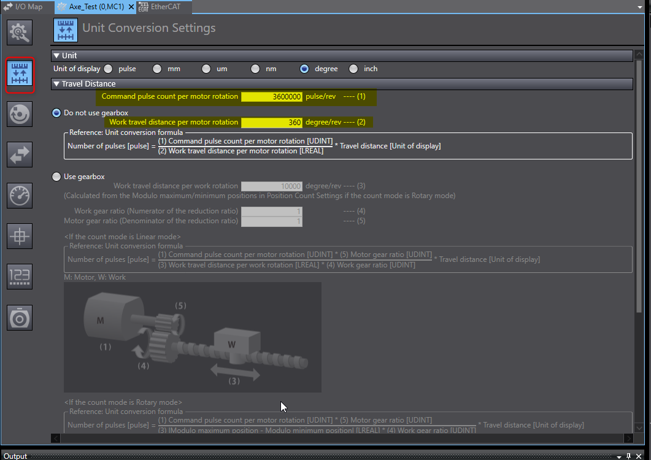
Axis Scaling
OMRON PLC with ctrlx Drive on EtherCat CoE
The scaling has to be done in the control
Exemple for rotary Axis

Slide 9
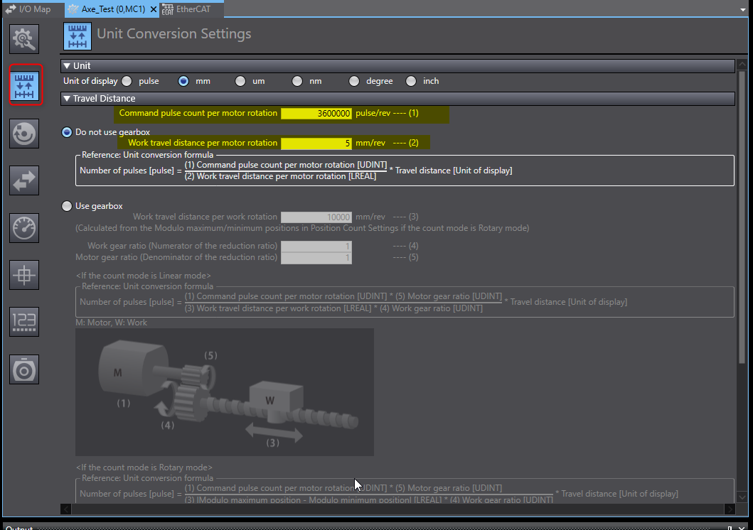
Axis Scaling
OMRON PLC with ctrlx Drive on EtherCat CoE
The scaling has to be done in the control
Exemple for Linear Axis

Slide 10
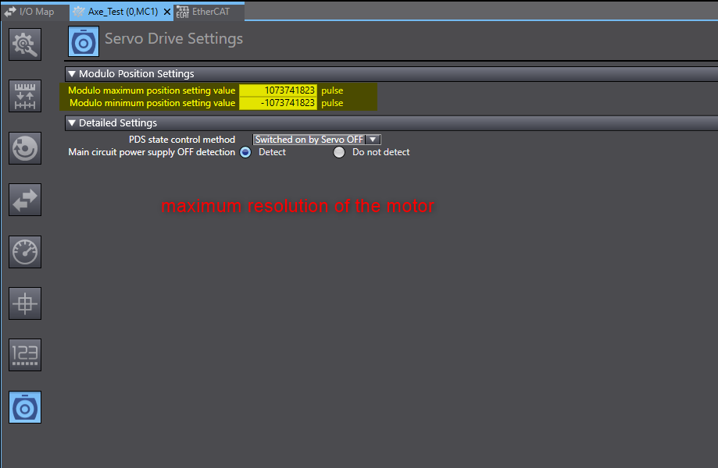
OMRON PLC with ctrlx Drive on EtherCat CoE

Slide 11
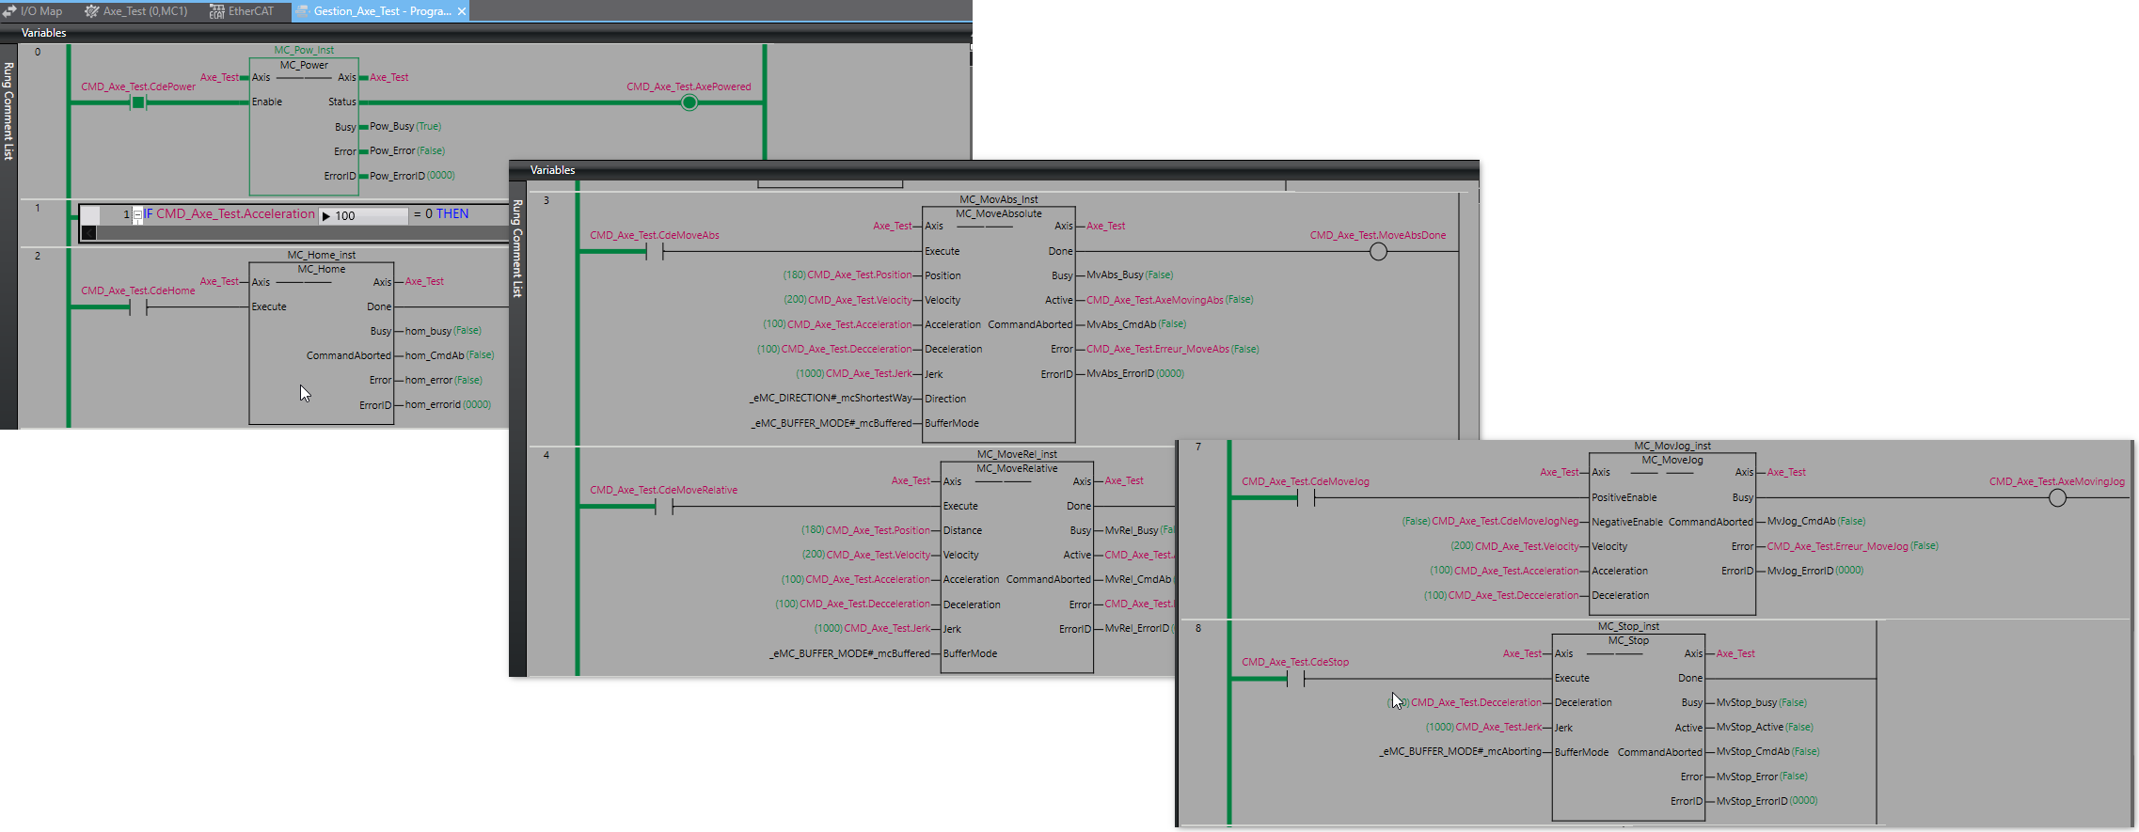
Programming
OMRON PLC with ctrlx Drive on EtherCat CoE

Slide 12
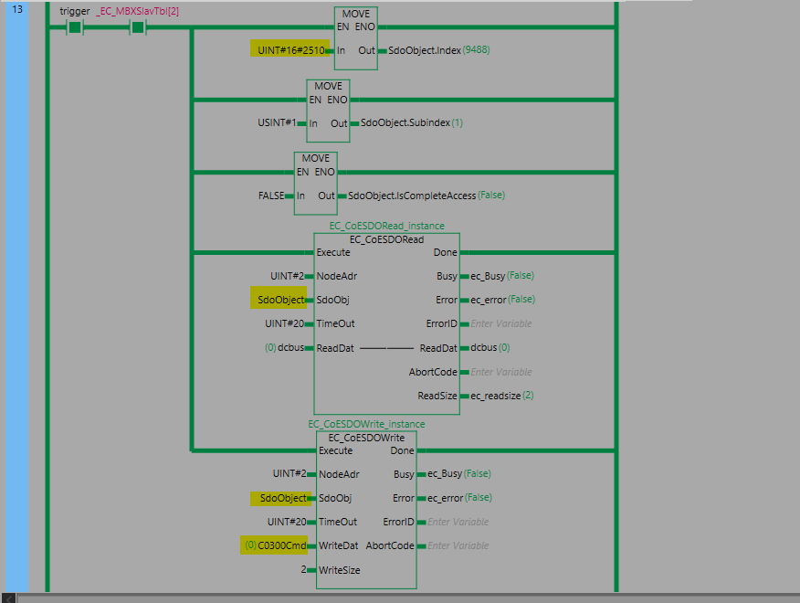
Read- Write paramaters
OMRON PLC with ctrlx Drive on EtherCat CoE
Follow slide 3, in order to get the CAN Parameter of each ctrlx Drive

