Slide 1
Profinet Participant assign a name

Slide 2
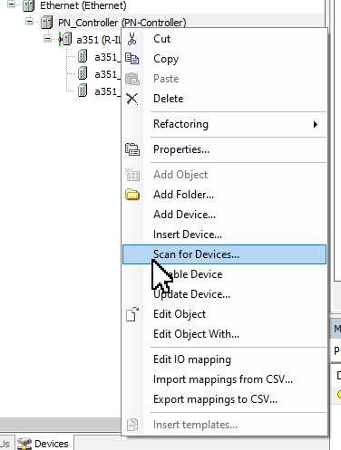
assign a name and IP adress
Profinet participant
right mouse click

Slide 3
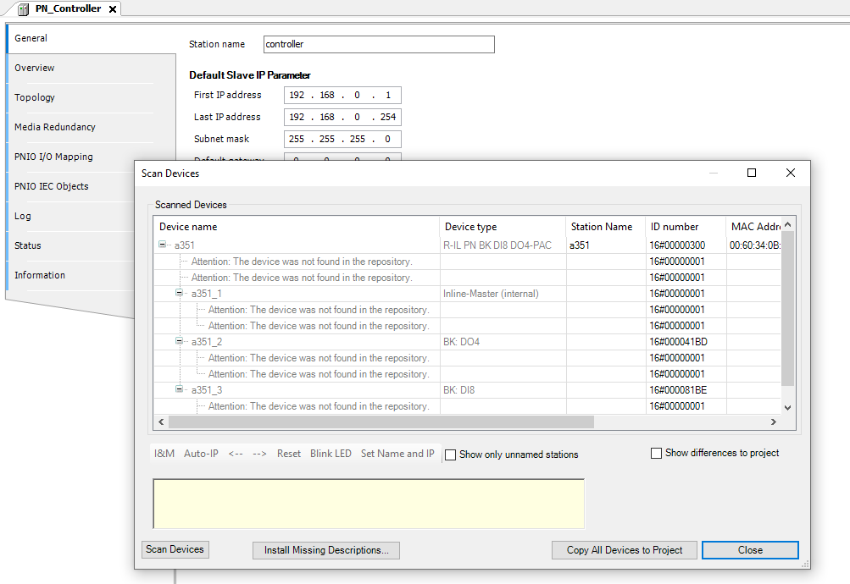
assign a name and IP adress
Profinet participant

Slide 4
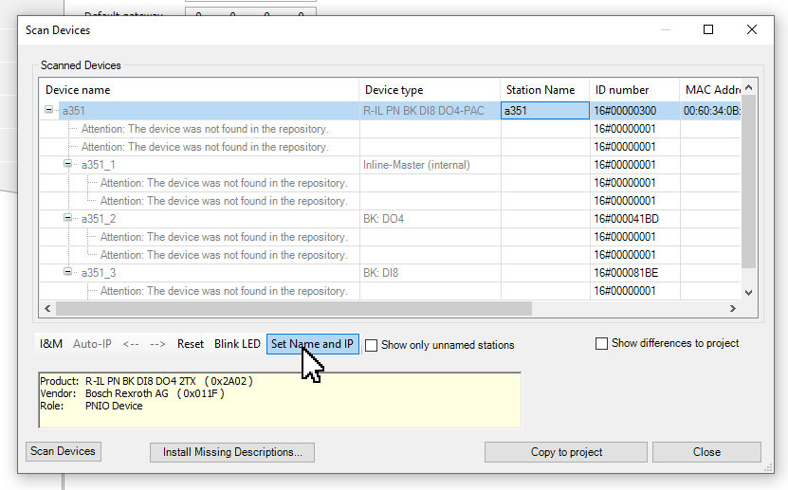
assign a name and IP adress
Profinet participant

